Slide 1
Capstone Interim Presentation
Direct Expansion Solar Assisted Heat Pump (DX-SAHP)
Charuka Marasinghe
Dhruvi Patel
Edwin Pulikkottil
Jessica Sambi
Kerwin Virtusio
Nadia El Gamal
Dec 01, 2021
Notes:
Hi everyone, my name is Kerwin and these are my team members, C D J K and N
We’re excited to present our capstone progress review on the direct expansion solar assisted heat pump,
or DX-SAHP for short
15s

Slide 2






Member Roles
Project
Manager
Collector Design/Sizing
Component Matching
Assembly
Lead
Control and Data Acquisition System
Testing
Lead
Kerwin
Virtusio
Nadia
El Gamal
Jessica
Sambi
Charuka
Marasinghe
Dhruvi
Patel
Edwin
Pulikkottil
Notes:
30s

Slide 3
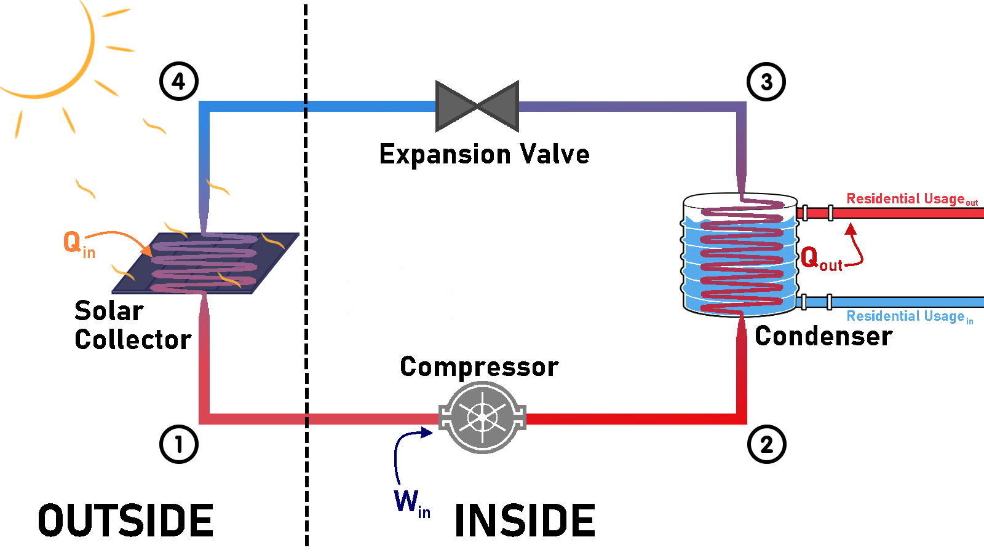
Project Overview - DX-SAHP
Notes:
1 min Ment

Slide 4
Goals & Major Deliverables
Design a Solar Thermal Collector
Optimize area and reduce radiative and convective heat losses
Match System Components
Complete with necessary control and data acquisition systems
Assemble and Test Working Model
Test in proposed design locale (Calgary)
Validate Quantifiable Goals
225L domestic hot water / day design goal
Coefficient of Performance (COP) > 2.3
Environmental Impacts
Notes:
Design a thermal solar collector capable of satisfying the heat load requirements of an average canadian household. This is roughly 225 Litres of hot water per day.
Perform a component matching analysis to design an integrated Solar Thermal Hot-water System, complete with all necessary control and data acquisition systems.
Assemble and test a working model to consolidate the system’s subcomponents and test them in the proposed design locale(Calgary).
Validate quantifiable and measurable goals:
Do we achieve our design goals (225 L) with a reasonable COP?
Do the Return on Investment and societal shift to renewables justify the proposed system?
30-45 s

Slide 5
Milestone Update
Nov. 15, 2021
1st iteration of collector design
Dec. 1, 2021
Final design with all compatible components
COMPLETED
FINAL PHASES
Dec. 10, 2021
Complete Bill Of Materials (BOM)
IN PROGRESS
Mar. 1, 2022
Begin testing
Notes:
We aim to have the first iteration of the collector design along with top 3 of each component chosen by November 15, 2021 so that we can have our final design completed with all of the final components selected by December 1, 2021. From here, we aim to have a completed bill of materials so we are able to order all parts by December 10 giving us about an 8-week lead time. We hope to receive our parts by the first to second week of February giving us 3-4 weeks to get our prototype ready. We hope to begin testing of our prototype by March 1, 2022.
45s

Slide 6


Component Selection
Notes:
20sec

Slide 7
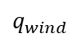
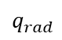
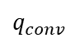
Refrigeration Selection (Charuka)
Collector Design
Solar Radiation
Reflection
Glass Cover
Absorber Plate
Copper Manifold
Overall Heat Loss Coefficient for the Collector Plate!
Notes:
1.5 mins????

Slide 8
Collector Design (Nadia)
Refrigeration Selection (Charuka)
Collector Design
Solar Radiation
Reflection
Glass Cover
Absorber Plate
Copper Manifold
Overall Heat Loss Coefficient for the Collector Plate!
Notes:
5 mins

Slide 9
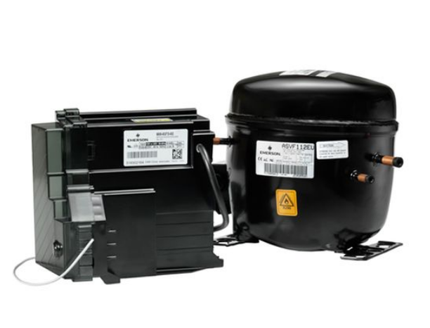
Compressor Selection
Hermetic Variable Speed Compressor
Compatible with R-410A and piping size
Evaporation Temperature Range: -8 to +10 deg. C
Maximum Condensation Temperature: + 60 deg.C
Power Input: ~1.138 HP (0.837 kW)
Single Phase, 110/115 Volts @ ~ 60Hz
Notes:
1 min

Slide 10
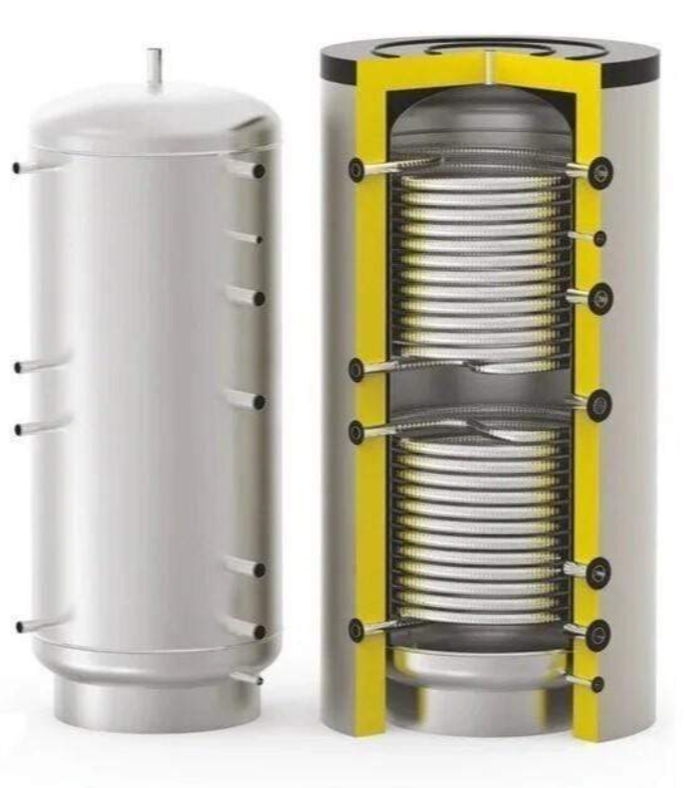
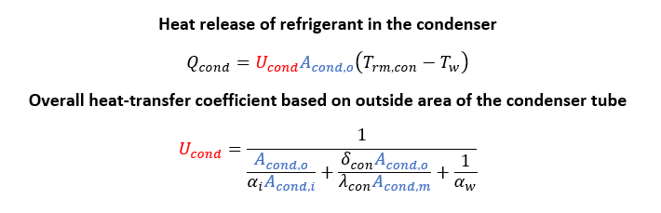
Condenser
Based on amount of heat that will be expelled in the condenser and total length of condenser coil
Needs at least 225L capacity
Consider max pressure and temperature
Pipe diameter was found to be 19mm which is ~¾”
Notes:
- The parameters that were considered to select the condenser were the minimum hot water requirement of 225L, the max pressure of 3600 kPa, and max temperature of 86C
- The heat release in the condenser, Q_cond, is variably dependant on the overall heat transfer coefficient, U_cond
- Now, U_cond is dependent on the total area of the copper coil in the condenser
- The pipe diameter was found to be 19mm which is approximately ¾”
45s

Slide 11
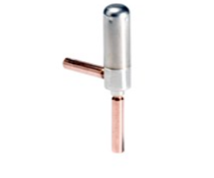
Expansion Valve
Based on refrigerant type
Vendors give rated capacity (kW) based on AHRI standards of T_evap, T_sat, and subcooling at EXV inlet
To see if this rated capacity works we need to apply a correction factor to our system capacity of 2.5 kW. This correction factor depends on refrigerant type, our system’s design T_conds, lowest T_evap our system will face, and subcooling at EXV inlet. Since our piping design is not finalized, for now we just assumed a subcooling of 4 Kelvin based on similar systems. Now that we know our corrected system capacity, we can compare it to different EXV rated capacities and find one that sufficiently fits in the valve operating range.
Notes:
- The selection of the EEV is based on the type of the refrigerant and the rated capacity of the valve
- The capacity is based on AHRI standards of the evaporating and saturation temperatures at the EEV inlet
- To apply the rating to our system capacity of 2.5kW we need to apply a correction factor based on the refrigerant and subcooling of our system
- Since our piping is not finalized, we assumed a subcooling of 4 kelvin based on similar system designs
45s

Slide 12
Piping
Pressure drop for smaller diameters was found to be much greater
Working pressure for ¾” Type M copper tube is 4700 kPa
Our max system pressure is approximately 3600 kPa
Pressure drop for the system was found to be minimal
Ranges from 0.5 to 2.5 kPa per meter of ¾” piping
Calculated using the Colebrook White equation
Notes:
45s

Slide 14

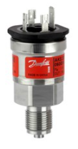
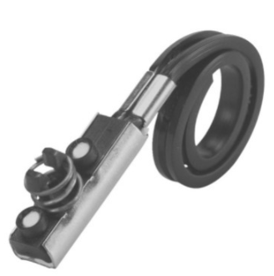
System Controls
Mass Flow Rate Control
Compressor Speed Control
Outlet Condition of 60℃, 3600 kPa
Varying Inlet Conditions
vapour
Notes:
2.5mins

Slide 15
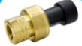

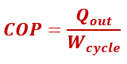
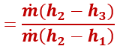
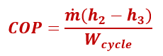
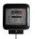
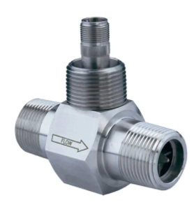
Data Acquisition
Notes:
2.5mins

Slide 16
Progress
Current Stage
Next Steps
Collecting cost and lead time quotes from suppliers
Bill of Materials
Finalizing component matching
Test plan creation
Economic Study
Modelled Assembly
Notes:
.75 mins

Slide 17
Questions?

